Slide 1

Image Source

Slide 2
Welcome to Week 13
Lecture 2!
Database Design & Administration

Slide 3
Agenda
Review Basic SQL Queries
Database Design/Administration
Forward Engineering with MySQL Workbench
Advanced SQL Queries
Exporting MySQL Databases

Slide 4
Assignments
Core Assignments for this Week:
Queries: Sakila (Core)
Books (Core)
Project 3 - Part 1 (Core)
Assignment Deadline - This Week:
Extended until Sunday night 11:59 PM PST
Allows time for installation troubleshooting
More lecture time to cover everything needed.

Slide 5
Reviewing Basic SQL Queries

Slide 6
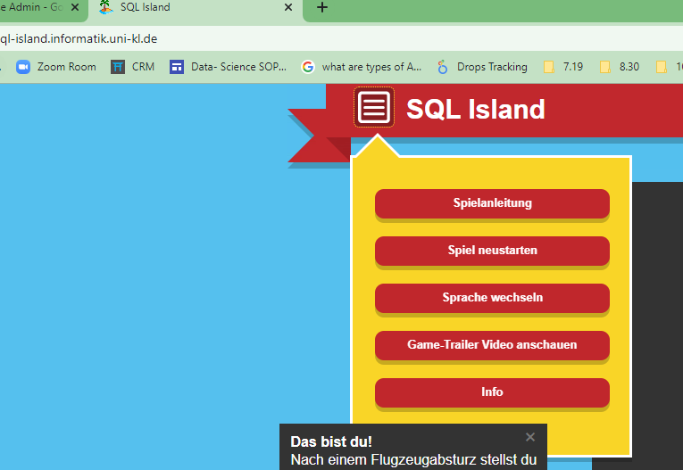
Resources/Practice
Guided Practice on Basic SQL Queries: https://sqlzoo.net/wiki/SQL_Tutorial
Good SQL Cheat Sheet: Google Drive Link
Game to Practice SQL: SQL Island (Note: defaults in German)
To change languages

Slide 7
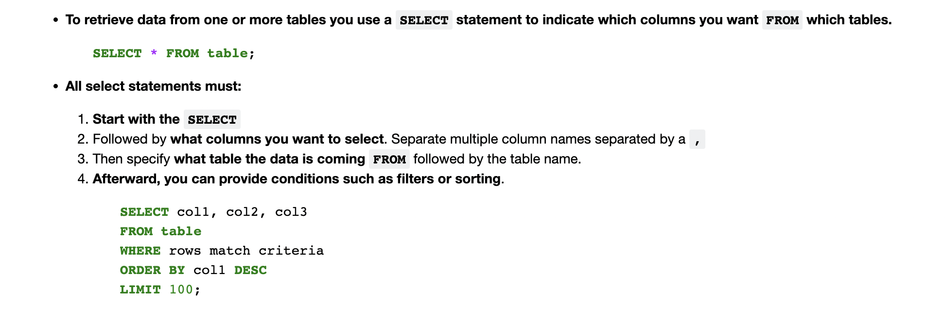
Querying Databases - SELECTing data

Slide 8
SQL Gotcha’s
WHERE VS HAVING:
Use WHERE to filter for a specific condition.
Use HAVING to filter for a specific condition after a GROUP BY
Aggregate Functions (SUM/COUNT/MIN/MAX/AVG)
Require a GROUP BY
Aliasing is used before its defined!
SELECT c.name
FROM customers AS c
AS is not required for table aliasing
SELECT c.name
FROM customers c

Slide 9
Relational Databases

Slide 10
What is a Relational Database?
A relational database is a data storage system that contains multiple tables that can be linked to each other (they are related).
The tables are linked via “keys”
Relational Databases are good for:
Highly structured data.
Reducing redundancy in data.
SQL is the programming language used by most relational databases.

Slide 11
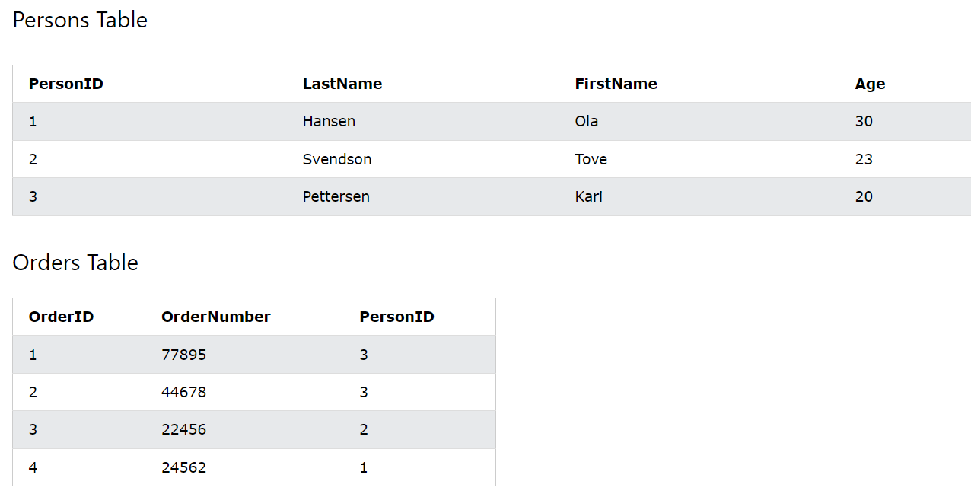
Keys link one table to another
Primary key of persons table
Primary key columns:
All unique values - no repeats (like an ID number).
Cannot contain null values.
Only one primary key per table.
Foreign keys
References the primary key in another table.
Used to match related data across tables.
Foreign Key in Orders table referencing primary key in Persons table
Notice how every time an order is placed, we don’t need to repeat all the customer info. We can just link to it with the foreign key.
Image from W3Schools

Slide 12
Entity Relationship Diagram (ERD)-provides an overview of all the tables and relationships
An entity is essentially anything that can have information stored about it: It can be a person, thing, concept, or event.
In a relational database, each “entity” has its own table.
Each table contains the attributes associated with the entity
Entity
Attribute
Attribute
Attribute
Customer
Cust_ID
Name
Email
Phone
The entity is “Customer”
Each customer will have 4 attributes

Slide 13
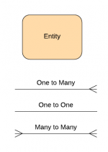
Types of Table Relationships
“Cardinality” (in database design) is how many times can an entity exist in relation to another entity. In other words, it is how many possible matches can there be for any individual ID.
One to one (1:1) relationships
One record only associated with one record in another table
Example: Each Cust_ID in the Customers table can only be related to one entry in the Contact table
One to many (1:M) relationships
One record can be associated with more than one record in another table
Example: Each Cust_ID can be associated with multiple orders
Many to Many (M:M) relationships
One record from either table can be associated with many records from another table.
Example: A student can enroll in multiple courses, and a course can have multiple students
Image Source
Check out this link at Database Star for examples of notation methods for representing cardinality and different types of ERDs.

Slide 14
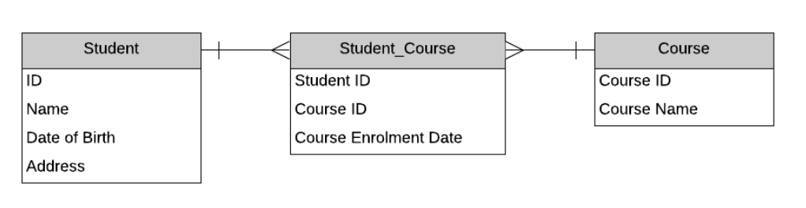
Example ERD
Joiner Table
Source is databasestar.com

Slide 15
Database Normalization

Slide 16
Database Normalization
“Database normalization is simply a convention for splitting large tables of data into smaller separate tables with the primary goal being to not repeat data.”
There are three conventions/”Forms” for data normalization:
1st Form Normal (1NF):
Each column can only have 1 piece of information.
No lists of values.
2nd Form Normal (2NF):
Each column must have unique values for every row, with the exception of foreign key columns.
3rd Form (3NF):
No non-key column is dependent on another non-key column.
Each column is describing something about the associated primary key.

Slide 17
Appointments Flat File
Patient Name | Patient Address | Date of Appointment | Time of Appointment | Primary Reason | Doctor Seen | Location | Location Address | Charge Tier | Charge
Sandy Summers | 101 Happy Lane, Greenville, SC | 4/21/2022 | 3:00 | Splinter | Dr. Who | North Office | 1000 Main St, Greenville, SC | 1 | 50
Angel Autumn | 208 Peaceful Ave, Anderson, SC | 4/21/2022 | 4:00 | Headache | Dr. What | South Office | 500 Oak St, Greenville, SC | 2 | 100
Wendy Winter | 400 Calm Way, Clemson, SC | 4/20/2022 | 2:30 | Appendix | Dr. When | North Office | 1000 North Main St, Greenville, SC | 3 | 200

Slide 18
Group Activity

Slide 19
Using MySQL Workbench, make an ERD for the Appointments Flat File
Consider how to best meet the conventions of normalization
Consider which type of relationships are needed
Note that a patient can have multiple reasons for a visit
Also note that a doctor can work in multiple locations
A low charge tier always costs $50, medium $100, and high $200
With MySQL Workbench, it is often easier to “think it through” as you create the model!
Once you have designed the model, save it!
Forward engineer it to create (an empty) database!

